Slide 1
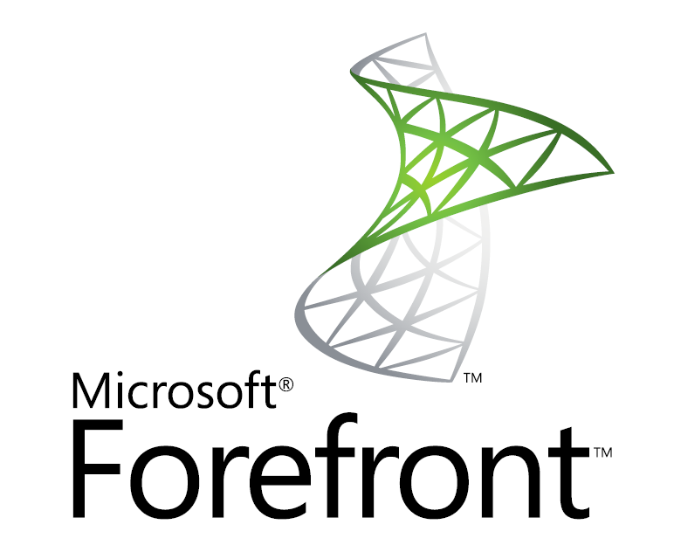
Kako povečati varnost omrežja s Forefront TMG
Jože Markič, Kompas Xnet d.o.o.
joze.markic@kompas-xnet.si

Slide 2
Agenda
Kaj je TMG?
TMG postavitve
Primerjava z ISA
Subscriptions
Secure Web Gateway
  HTTPS inspection
  URL filtering
  Malware protection
  Intrusion prevention

Slide 3





Forefront Edge Security and Access Products
The Forefront Edge Security and Access products provide enhanced network edge protection and application-centric, policy-based access to corporate IT infrastructures
Before
Now
Network Protection
Integrated and comprehensive protection from Internet-based threats
Network Access
Unified platform for all enterprise remote access needs
Notes:
3

Slide 4







Forefront TMG Value Proposition
Firewall – Control network policy access at the edge
Secure Web Gateway – Protect users from Web browsing threats
Secure E-mail Relay – Protect users from
e-mail threats
Remote Access Gateway – Enable users to remotely access corporate resources
Intrusion Prevention – Protect desktops and servers from intrusion attempts
Comprehensive
Integrated
Simplified
Notes:
4

Slide 5
Forefront TMG Deployment Scenarios
Unified Threat Management (UTM)
All-in-one solution for medium businesses
Firewall, VPN, Web security, IPS, e-mail relay in a single box
Secure Web Gateway
Authenticating proxy with security
Remote Access Gateway
Secure E-mail Relay
Web antivirus and URL filtering
Dial-in VPN
Site to site VPN
Antispam
Antivirus
E-mail filtering
Inspection of HTTP and HTTPS traffic
Secure Web publishing
Notes:
5

Slide 6
Features Summary
Firewall
Secure Web Access
E-mail Protection
HTTP antivirus/
antispyware
Antivirus
Intrusion Prevention
Network inspection system
Remote Access
NAP integration with client VPN
Deployment and Management
VoIP traversal
Enhanced NAT
ISP link redundancy
URL filtering
HTTPS forward inspection
Antispam
Exchange Edge integration
Enhanced reporting
Array management
W2K8, native 64-bit
Change tracking
Subscription Services
Malware protection
SSTP integration
URL filtering
Intrusion prevention
Notes:
6

Slide 7
Features Summary
Comparing with ISA Server 2006
ISA Server
2006
Forefront
TMG
Network layer firewall
✓
✓
Application layer firewall
✓
✓
Internet access protection (proxy)
✓
✓
Basic OWA and SharePoint publishing
✓
✓
Exchange publishing (RPC over HTTP)
✓
✓
IPSec VPN (remote and site-to-site)
✓
✓
Web caching, HTTP compression
✓
✓
Windows Server® 2008 R2, 64-bit (only)
✓
New
Web antivirus, antimalware
✓
New
URL filtering
✓
New
E-mail antimalware, antispam
✓
New
Network intrusion prevention
✓
New
Enhanced UI, management, reporting
✓
New
Notes:
7

Slide 8
Forefront TMG Licensing
Two editions and Two Client Access Licenses (CALs)
E
Enterprise Edition
Scalability and management
Standard Edition
Full UTM
Subscriptions
Web protection
E-mail protection
Notes:
8

Slide 9
Comparing Forefront TMG Editions
 | Standard Edition | Enterprise Edition
Number of CPUs | Up to 4 CPUs | Unlimited
Array/NLB/CARP support | ✗ | ✓
Enterprise management | ✗ | Yes, with added ability for EMS to manage SEs
Publishing | ✓ | ✓
VPN support | ✓ | ✓
Forward proxy/cache, compression | ✓ | ✓
Network IPS (NIS) | ✓ | ✓
E-mail protection | Requires Microsoft® Exchange Server License (Server + CALs) and installation by the admin
Notes:
9

Slide 10
Subscriptions
Subscription-based licenses
  Sold as Client Access Licenses (CALs)
  Charged per user/per year
Protection Components
  E-mail protection
    Antispam
    Antivirus
  HTTP protection
    Antimalware
    URL filtering
  Network Inspection System is free!
Notes:
10

Slide 11
Single Adapter Scenario
Forefront TMG supports using a single network adapter
Supported scenarios
  Secure Web Gateway (forward Web proxy and cache)
  Web Publishing (reverse Web proxy and cache)
  Remote client VPN access
Unsupported scenarios
  Application layer inspection (except for Web proxy)
  Server publishing
  Non-Web clients
    Firewall client
    Secure NAT
  Site-to-site VPNs

Slide 12
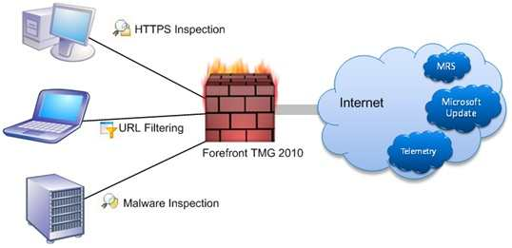
Secure Web Gateway

Slide 13
Threats and Controls
Threats | Application Layer Firewall | HTTPS Inspection | Anti- malware | URL Filtering | NIS
Malware
Phishing
Liability
Data Leakage
Lost Productivity
Loss of Control
Full
Partial
Enabler

Slide 14






Forefront TMG HTTPS Traffic Inspection
URL Filtering
Malware Inspection
Network Inspection System
SSL
SSL
SSL
HTTPS Inspection terminates the SSL traffic at the proxy for both ends, and inspects the traffic against different threats
  Trusted certificate generated by proxy matching the URL expected by the client

Slide 15

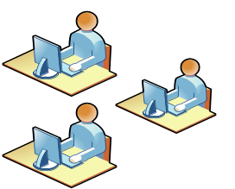
Enabling HTTPS Traffic Inspection
Configure HTTPS Inspection:
Proxy certificate generation/import and customization.
Source and destination exclusions
Validate only option
Notification
Certificate deployment
(via Active Directory® or Import/Export)
Client notifications about HTTPS inspection (via Firewall client)
Certificate validation (revocation, trusted, expiration validation, etc.)

Slide 16
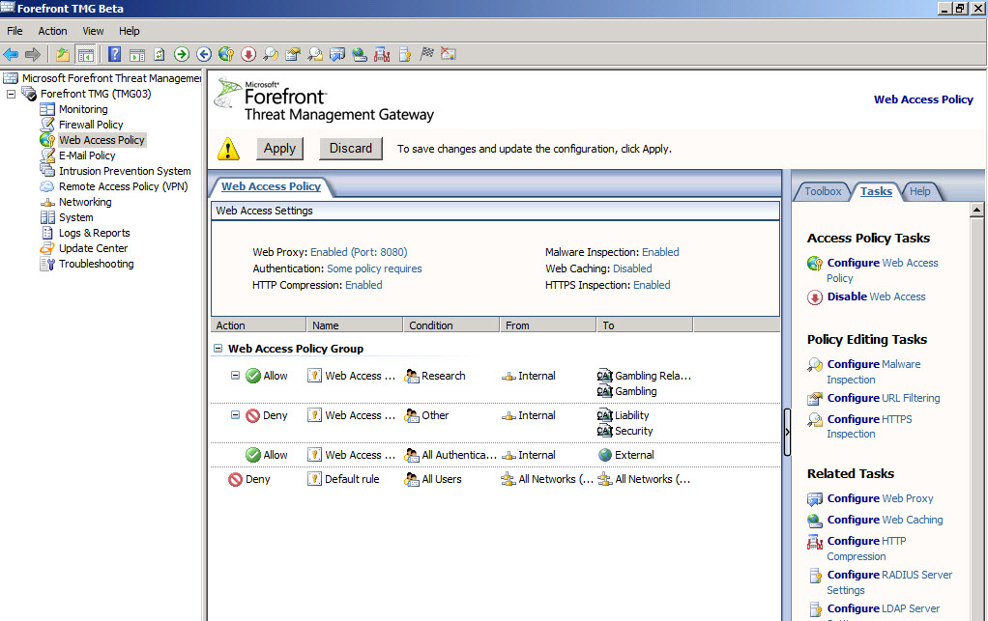
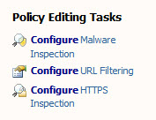
Configuring HTTPS Inspection

Slide 17
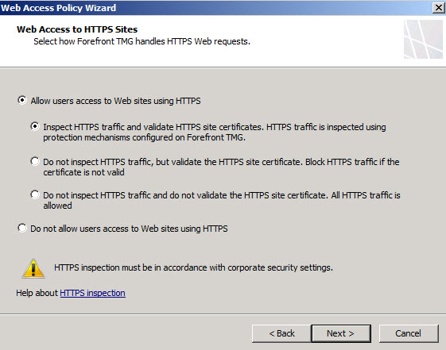
Configuring HTTPS Inspection

Slide 18
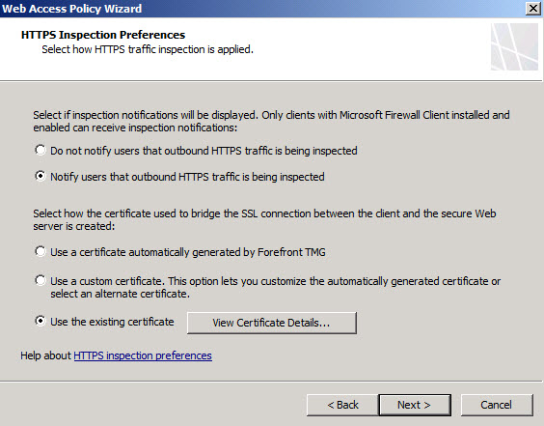
Configuring HTTPS Inspection

Slide 19
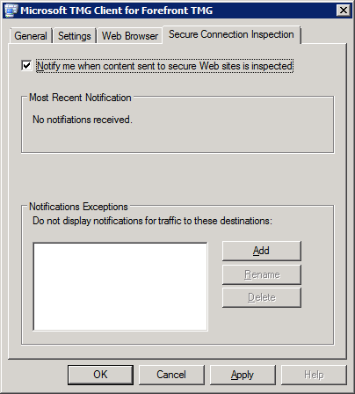
HTTPS Inspection Notifications
Notification provided by Forefront TMG client
  Notify user of inspection
  History of recent notifications
  Management of Notification Exception List
May be a legal requirement in some geographies

Slide 20
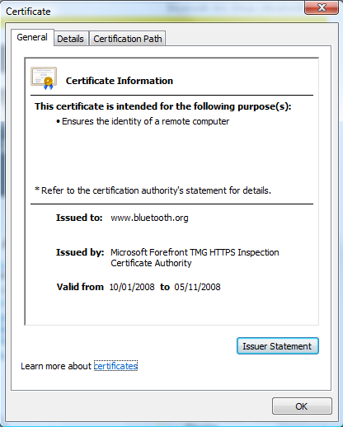
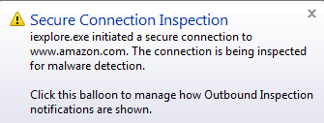
HTTPS Inspection Notification
User Experience

Slide 21


Forefront TMG URL Filtering
Integrates leading URL database providers
Subscription-based
91 built-in categories
Predefined and administrator defined category sets
Customizable, per-rule, deny messages
TMG
URL category override
URL category query
Logging and reporting support
Web Access Wizard integration

Slide 22
URL Filtering Benefits
Control user web access based on URL categories
Protect users from known malicious sites
Reduce liability risks
Increase productivity
Reduce bandwidth and Forefront TMG resource consumption
Analyze Web usage

Slide 23
What Makes MRS Compelling?
Existing URL filtering solutions
  Single vendor cant be expert in all categories
  Categorization response time
MRS unique architecture
  MRS merges URL databases from multiple sources/vendors
    Multi-vendor AV analogy
  Based on Microsoft internal sources as well as collaboration with third party partners
  Scalable
Ongoing collaborative effort
  Recently announced an agreement with Marshal8e6
  More announcements to follow

Slide 24


How Forefront TMG Leverages MRS
Multiple Vendors
Microsoft
Datacenters
MRS
Federated
Query
Combines with Telemetry Data
SSL
Telemetry Path
(also SSL)
Fetch on cache miss
SSL for auth & privacy
No PII
Feedback mechanism on Category overrides
Cache:
Persistent
In-memory
Weighted TTL
Cache
Query (URL)
Fetch
URL
Categorizer
Policy

Slide 25
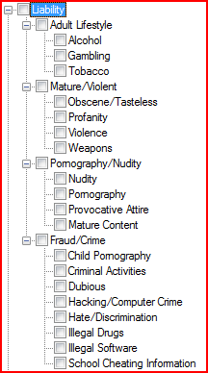
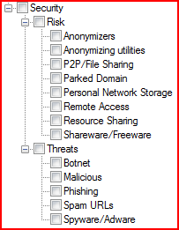
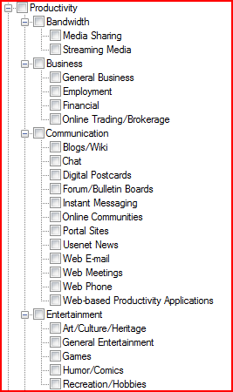
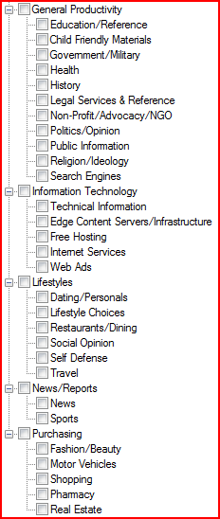
URL Filtering Categories
Security
Liability
Productivity

Slide 26
URL Filtering category precedence
No. Category
1 "Malicious"
2 "Pornography"
3 "Botnet"
4 "Phishing"
5 "Criminal Activities"
6 "Hate/Discrimination„
…
75 "Unknown"
http://www.microsoft.com/security/portal/mrs/

Slide 27
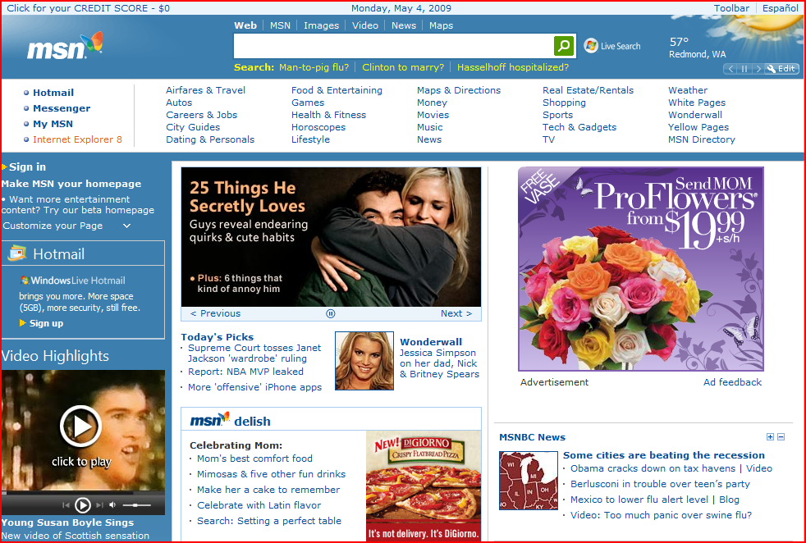
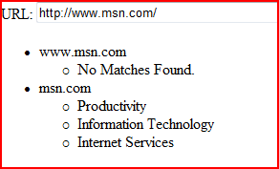
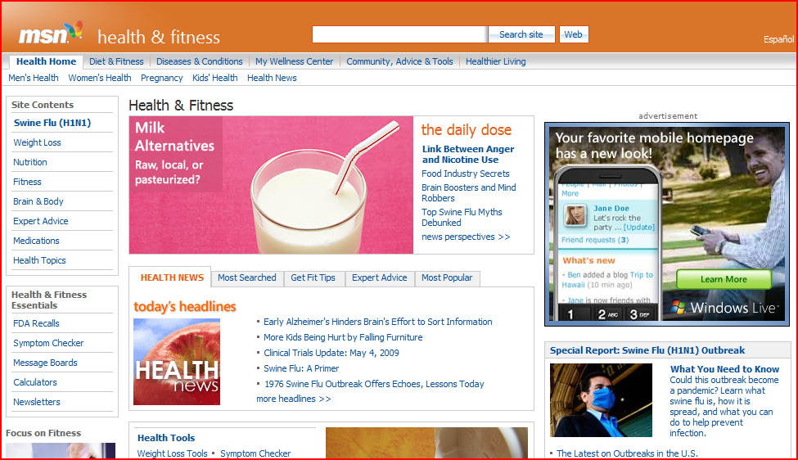
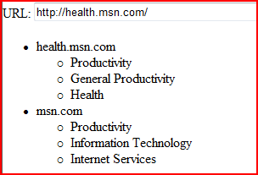

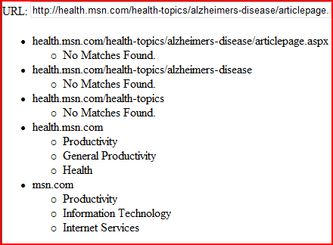
Categories and Inheritance

Slide 28
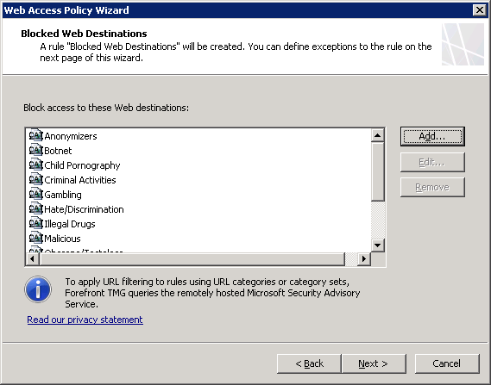
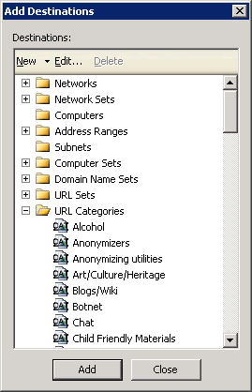
URL Filtering Policy
URL categories are standard network objects
Administrator can create custom URL category sets

Slide 29
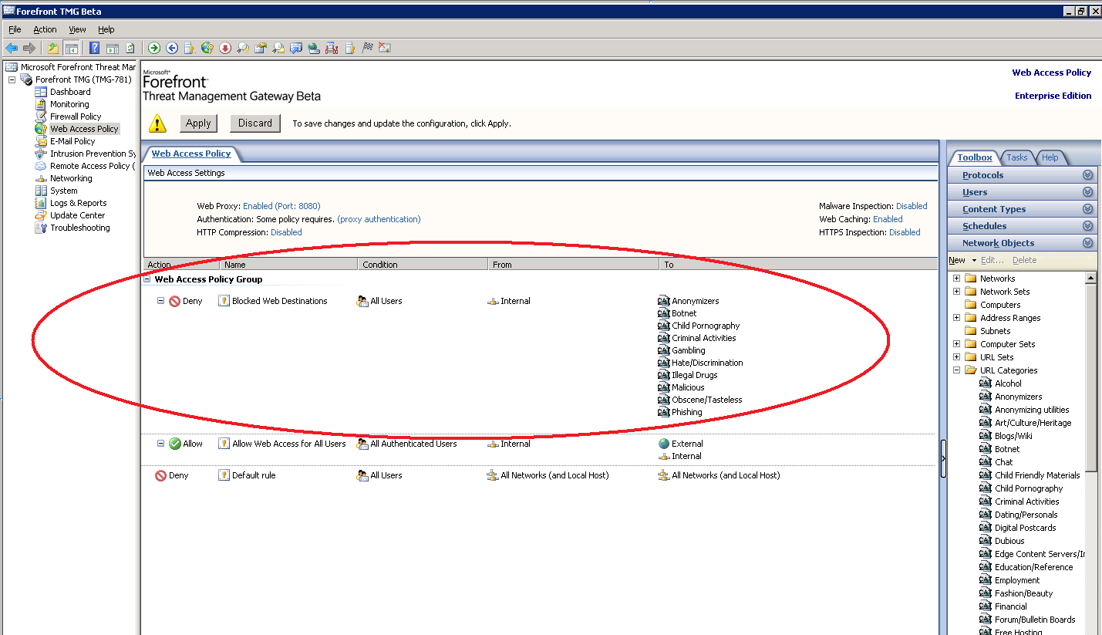
URL Filtering Policy

Slide 30
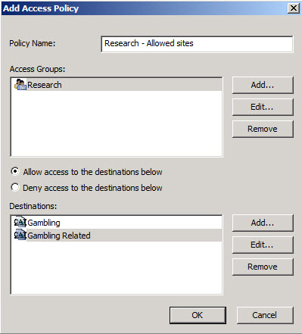
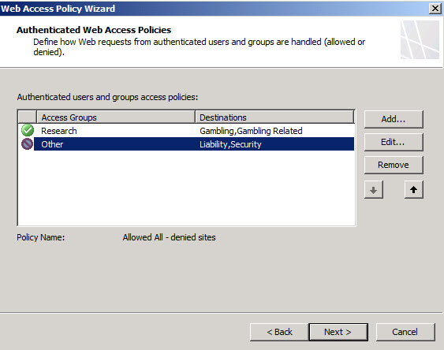
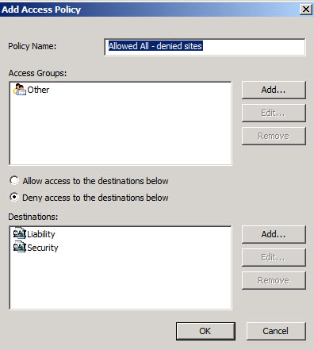
Contoso’s Web Access Policy
Access rule denying everyone access to Liability and Security sites
Access rule allowing users in the Research group to access gambling and gambling-related sites

Slide 31
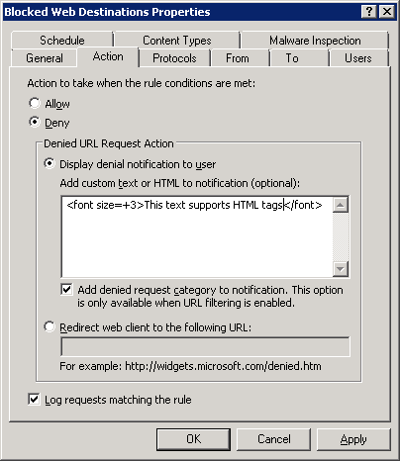
Per-rule Customization
TMG administrator can customize denial message displayed to the user on a per-rule basis
  Add custom text or HTML
  Redirect the user to a specific URL

Slide 32
URL Filtering Configuration

Slide 33
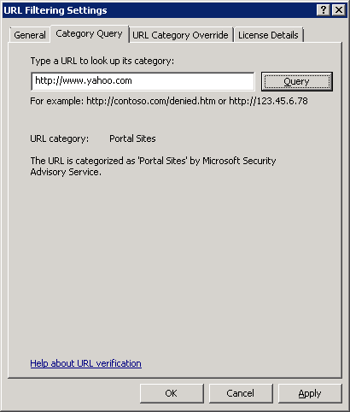
Category Query
Administrator can use the URL Filtering Settings dialog box to query the URL filtering database
  Enter the URL or IP address as input
  The result and its source are displayed on the tab

Slide 34
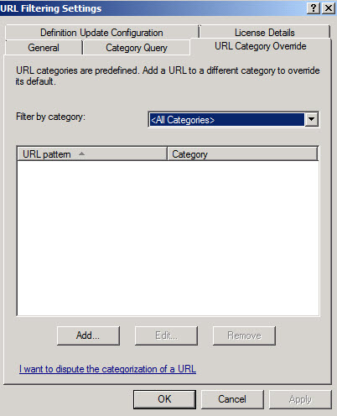
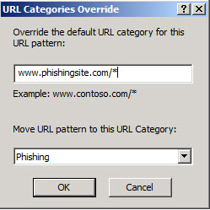
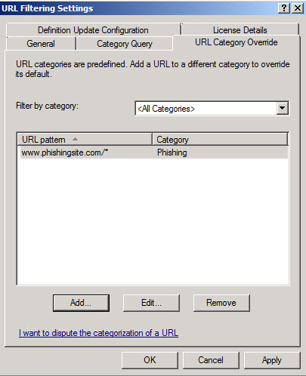
URL Category Override
Administrator can override the categorization of a URL
  Feedback to MRS
  via Telemetry

Slide 35
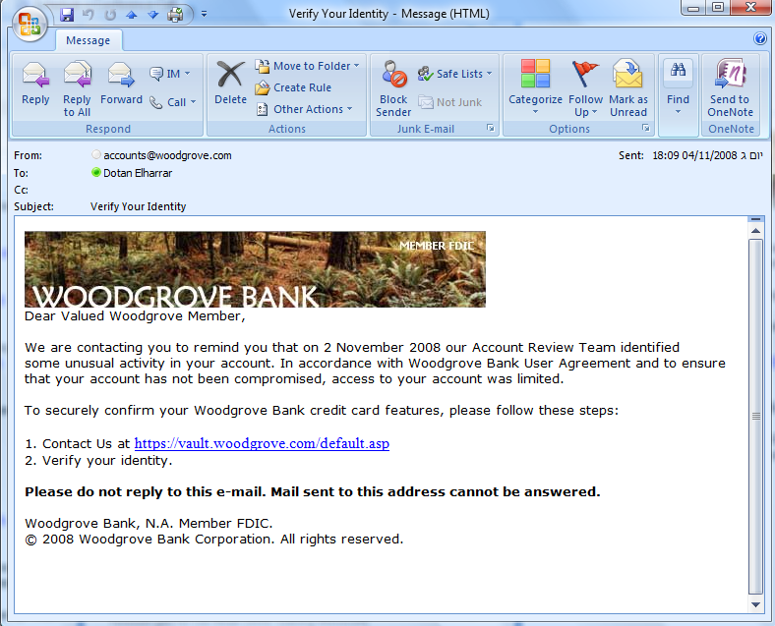
User Experience
http://www.phishingsite.com

Slide 36
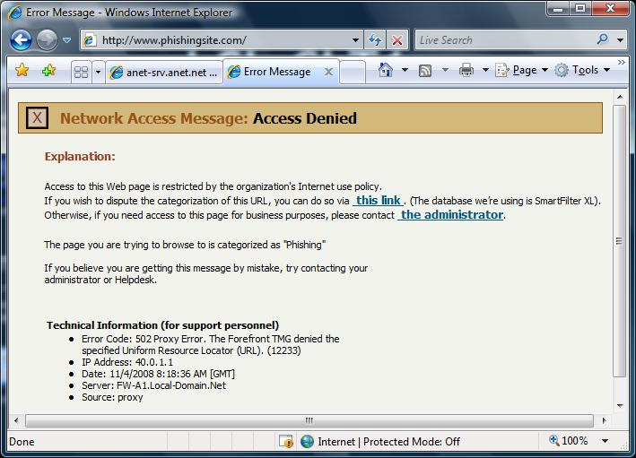
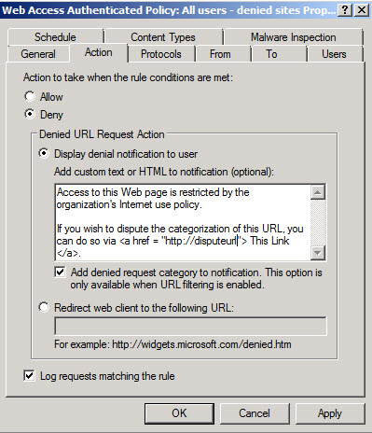
User Experience
HTML tags
36

Slide 37
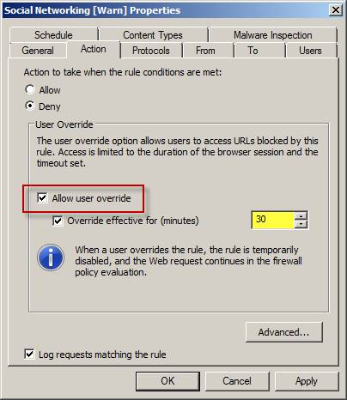
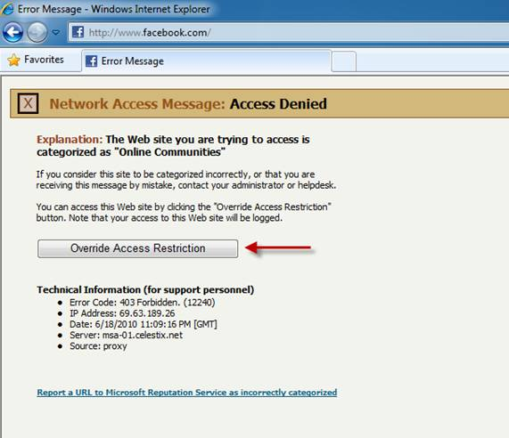
Novost v SP1

Slide 38
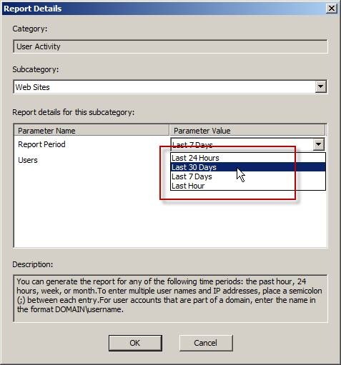
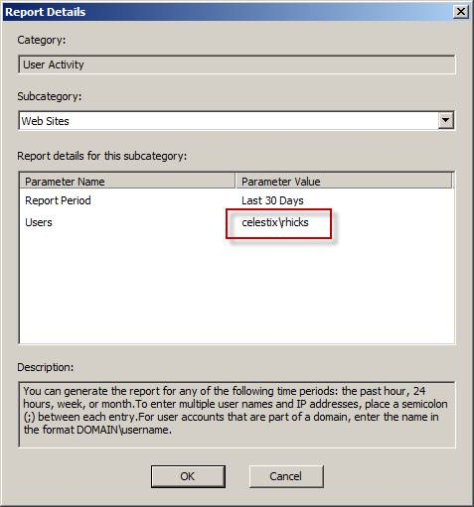

Slide 39
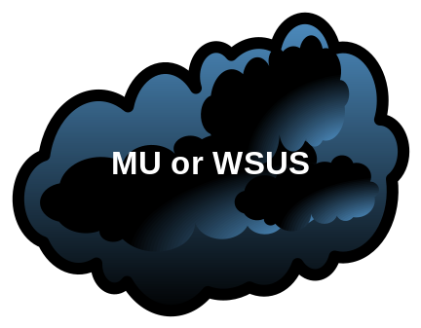

HTTP Malware Inspection
Integrates Microsoft Antivirus engine
Signature and engine updates
Subscription-based
Third party plug-ins can be used (native Malware inspection must be disabled)
Content delivery methods by content type
TMG
Source and destination exceptions
Global and per-rule inspection options (encrypted files, nested archives, large files…)
Logging and reporting support
Web Access Wizard integration

Slide 40


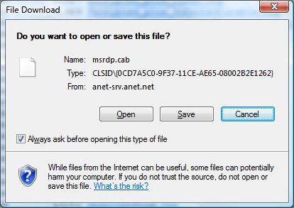
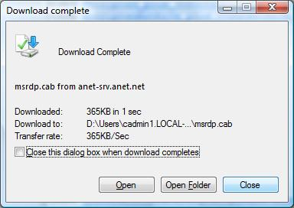
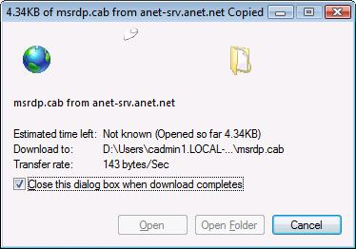

Content Trickling
Firewall Service
GET msrdp.cab
GET msrdp.cab
Web Proxy
200 OK
200 OK
Malware Inspection Filter
Request Context
Accumulated Content
Accumulated Content
Accumulated Content
Accumulated Content
Accumulated Content
Scanner

Slide 41
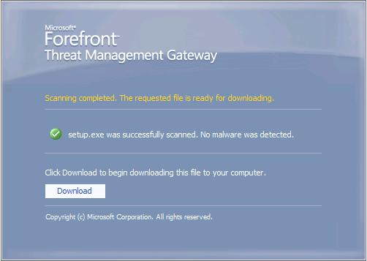
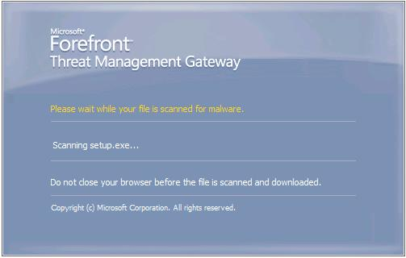
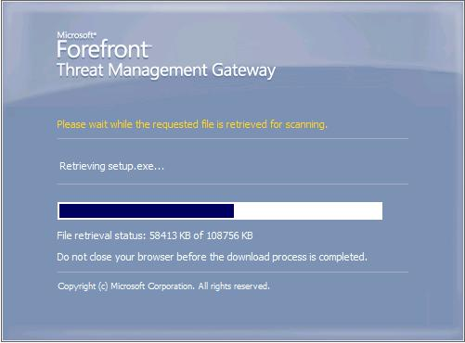

Progress Notification
Firewall Service
GET setup.exe
GET setup.exe
GET GetDownloadStatus
GET GetDownloadStatus
GET GetDownloadStatus
GET FinalDownload
Web Proxy
200 OK (setup.exe)
200 OK (HTML)
200 OK (Retrieving)
200 OK (Scanning)
200 OK (Ready)
200 OK (setup.exe)
Malware Inspection Filter
Primary Request Context
Accumulated Content
Accumulated Content
Accumulated Content
Secondary Request Context
Downloads Map
Scanner

Slide 42
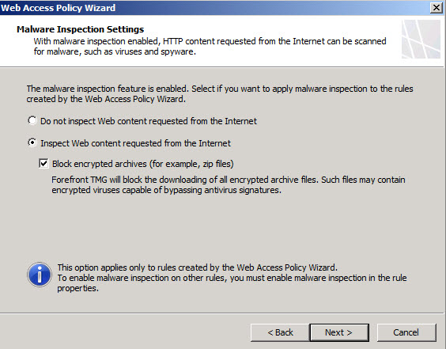
Enabling Malware Inspection
Activate the Web Protection license
Enable malware inspection on Web access rules
  Web Access Policy Wizard or New Access Rule Wizard for new rules
  Rule properties for existing rules

Slide 43
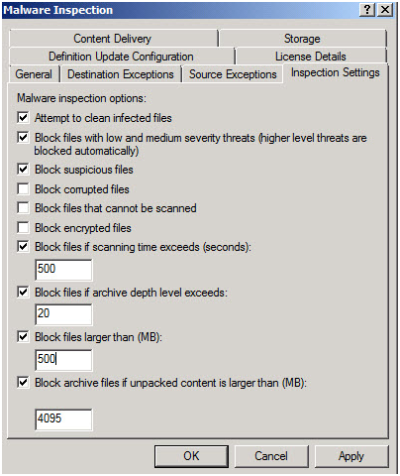
Malware Inspection Global Settings
Administrator can configure malware blocking behavior:
  Low, medium and high severity threats
  Suspicious files
  Corrupted files
  Encrypted files
  Archive bombs
    Too many depth levels or unpacked content too large
  File size too large

Slide 44
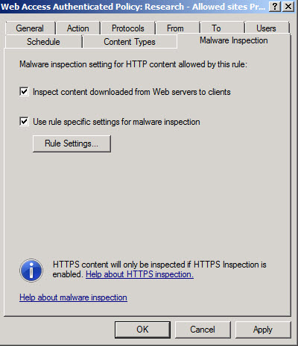
Malware Inspection Per-rule Overrides

Slide 45
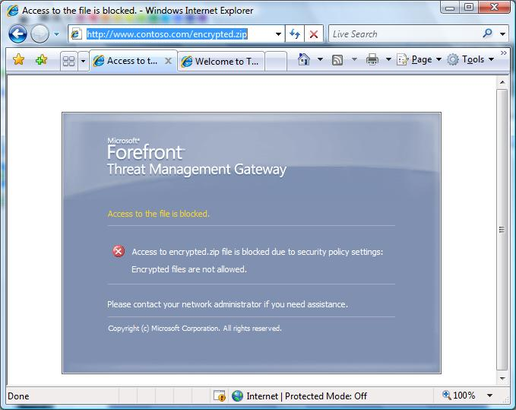
User Experience
Content Blocked

Slide 46
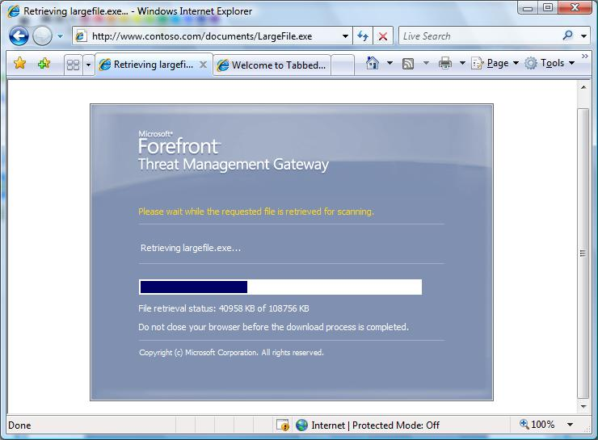
User Experience
Progress Notification
46

Slide 47
Network Inspection System (NIS)
Protocol decode-based traffic inspection system that uses signatures of known vulnerabilities
  Vulnerability-based signatures (vs. exploit-based signatures used by competing solutions)
  Detects and potentially block attacks on network resources
NIS helps organizations reduce the vulnerability window
  Protect machines against known vulnerabilities until patch can be deployed
  Signatures can be released and deployed much faster than patches, concurrently with patch release, closing the vulnerability window
Integrated into Forefront TMG
  Synergy with HTTPS Inspection

Slide 48







New Vulnerability Use Case
Vulnerability is discovered
Response team prepares and tests the vulnerability signature
Signature released by Microsoft and deployed through distribution service, on security patch release
All un-patched hosts behind Forefront TMG are protected
Corporate Network
Signature Authoring
Team
Vulnerability
Discovered
Signature
Distribution
Service
TMG
Signature
Authoring
Testing

Slide 49
NIS Response Process
Threat Identification
Signature Development
Signature Testing
Encyclopedia Write-up
Signature Release
Threat Research
Targeting 4 hours

Slide 50
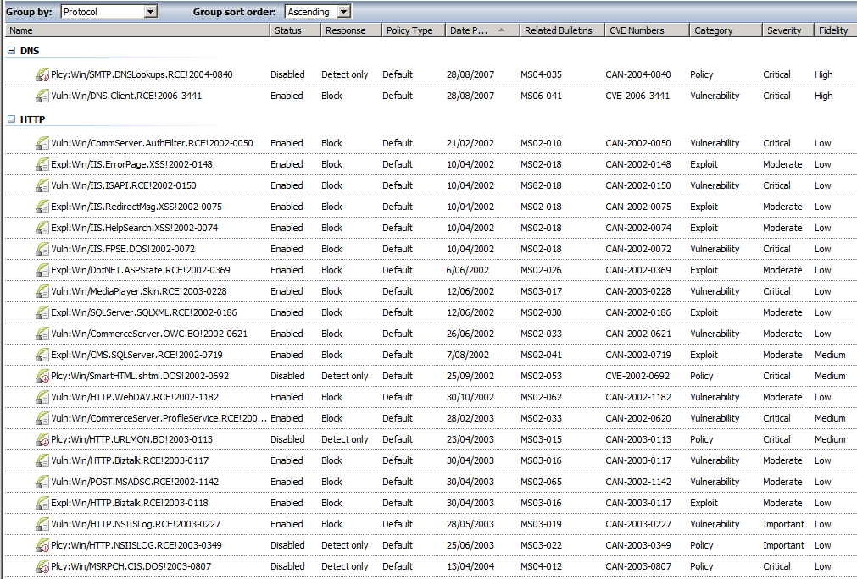









Enabling and Configuring NIS

Slide 51
Client Types
Web proxy client
  CERN-compatible browsers/applications
SecureNAT client
  Any host supporting IP
Forefront TMG client
  Formerly ISA firewall client
  Windows computers

Slide 52
Client Comparison
Feature | SecureNAT Client | Forefront TMG Client | Web Proxy Client
Installation required | IP Routing configuration | Yes | Web browser configuration
OS Support | Any OS supporting TCP/IP | Windows only | Any proxy-aware Web application
Protocol support | Requires application filters for multiple-connection protocols | All Winsock applications | HTTP, HTTPS, and FTP download
User-level authentication | No | Yes | Yes

Slide 53
Web Proxy Client Configuration
Generate configuration
Discover configuration
  Automatic configuration script
  Web Proxy Auto Discovery (WPAD)
  Static proxy configuration
Enforce configuration
  Manual
  Group policy
  Forefront TMG client

Slide 54
SecureNAT clients
Only requires proper routing
Clients perform DNS resolution
Limitations:
  No user information passed
  No support for secondary connections
  (without application filter)
Use for:
  Non-Web protocols
  Simple, unauthenticated protocols
  Non-Windows systems

Slide 55
Forefront TMG Client
Formerly known as ISA Firewall client
Supports all WinSock-based applications
  FwcWsp.dll registered with WinSock protocol stack
  FwcWsp tracks all WinSock calls
  All remote TCP calls sent to FWC listener (TCP 1745)
  User information passed on all requests
Use for:
  User-based access authentication to non-Web protocols
  Complex protocols with secondary connections

Slide 56

Forefront TMG Client Discovery
Secure discovery using Active Directory, with fallback to DHCP and DNS
  Secure discovery uses AD to store discovery information for domain members
  Forefront TMG client and Web proxy discovery
  Allows global and site-specific markers
  Configured using TmgAdConfig.exe
TmgAdConfig add –site <Site> -type <winsock|webproxy> -url <URL>

Slide 57



Server-side Configuration
Domains and Addresses tabs determine routing

Slide 58
?

